Slide 1
AURORA IN 2026
All you wanted to know, but were afraid to ask
NEVHF CONFERENCE 2026
Hartford, CT
David Olean K1WHS

Slide 2
Where did all The Auroras go?
In the 1970’s and 1980’s there were many more Auroras than we see now.
Kp Index of 5 or 6 would trigger a decent Aurora
After about 2014, There are no more Kp 5 or Kp 6 events! What is going on?
The Magnetic North Pole is moving farther away from the Northeast US.
Our magnetic latitude is dropping as actual magnetic flux is lower farther
from the pole.
We need a Kp of 8 or 9 to get a good Aurora in 2026.

Slide 3
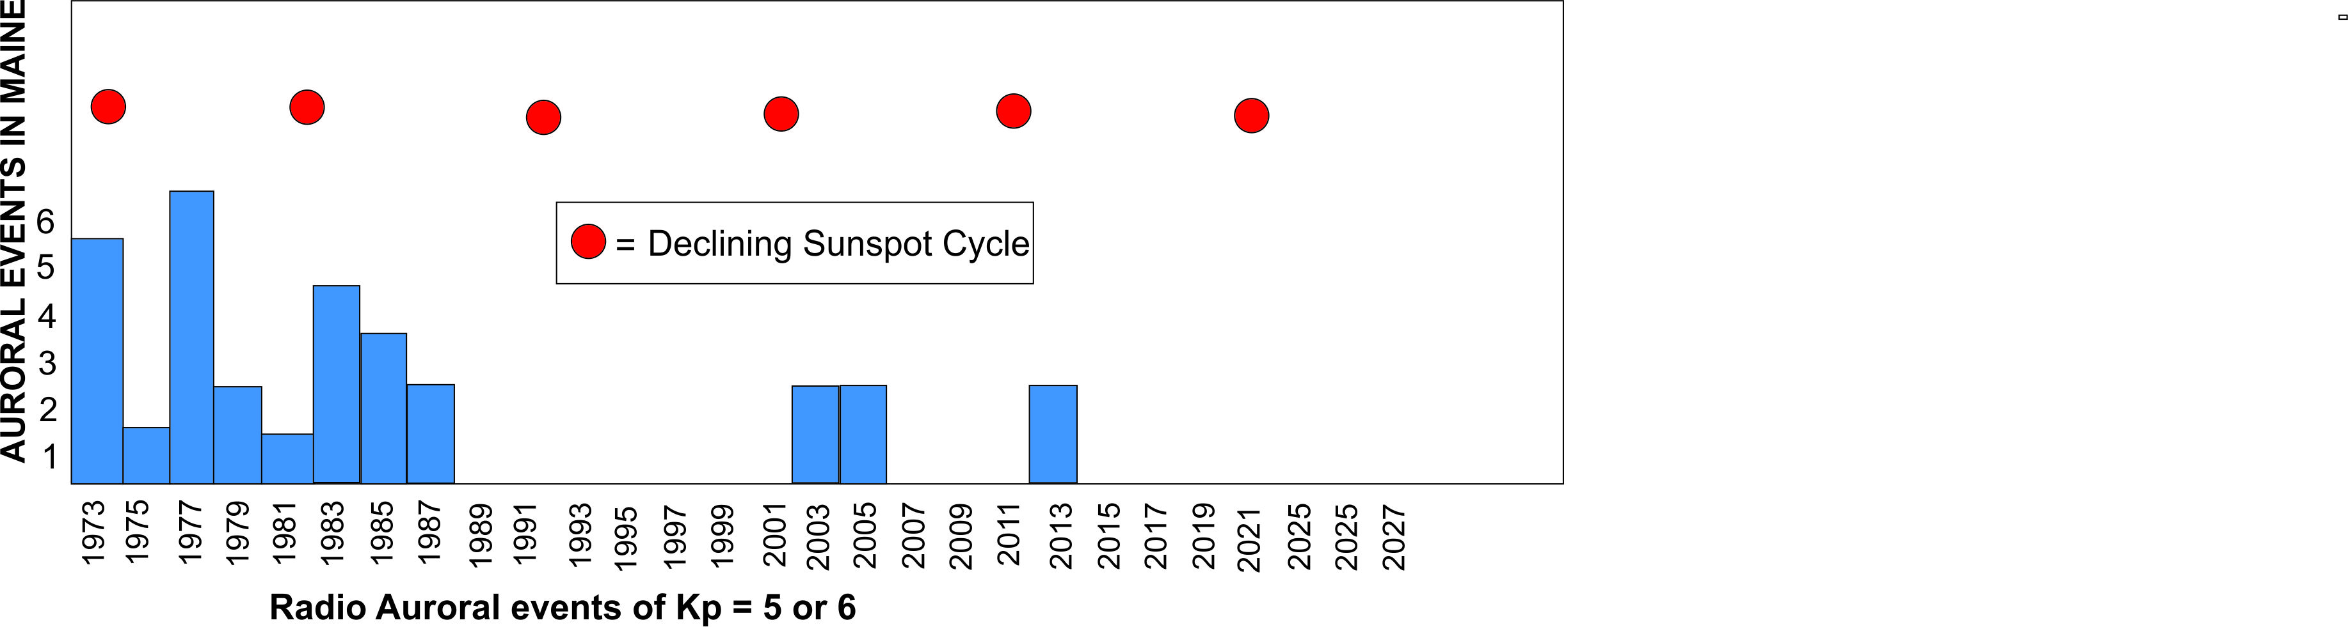
Kp 5 & 6 AURORAS Observed in Maine.
THE RED DOTS INDICATE SOLAR CYCLE PEAKS FOR BEST AURORA

Slide 4
Where did the Magnetic Pole go?
In the 1800’s it moved in small amounts of a few km per year.
In 1999, it was moving North at 60 km Northward per year
2020 Saw it go into overdrive and hit 78 km per year.
That is the distance from this hotel all the way to Bridgeport!
The direction is straight away from New England towards Siberia.
In 2050 it will be at 80 Degrees N. on the Siberian side of the globe.
In 1950 the pole was at about 75 degrees N. in Canada

Slide 5
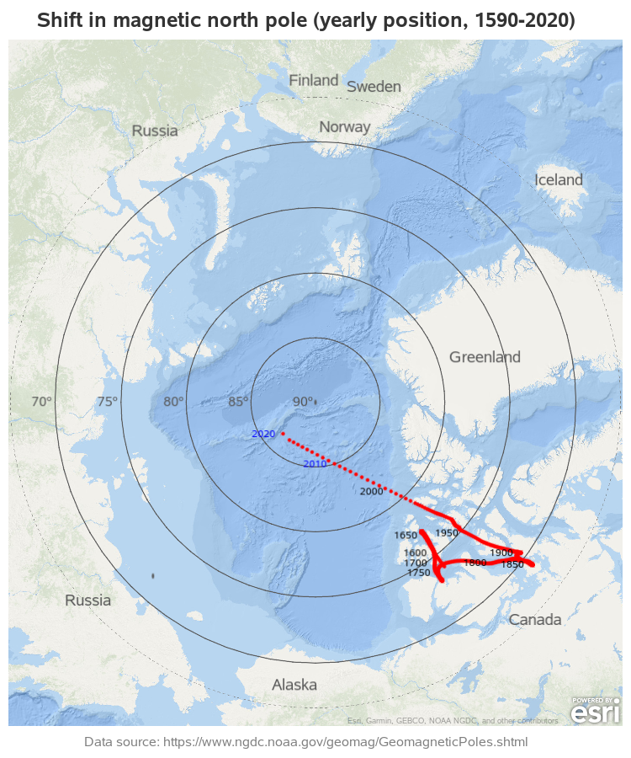

Slide 6
So, What do we do about the problem?
We have to learn how to operate “smarter”.
Please read the W3EP Mar 1990 QST, and VE3CIE Jan 1985 QST articles
We need to better understand Auroral propagation
We need to detect Auroral storms and be ready for them.
Magnetometers and online aids can help a lot with detection.
I want to discuss Auroral paths and how to better utilize them.

Slide 7
Earth Magnetic Field Definitions
Magnetic poles and Earths Magnetic field
Field lines and strength of the field
Field line inclination or magnetic dip angle.
See the map of North America to observe how the dip angle varies.
Magnetic declination or the variation from true North.
Can be positive or negative compared to true North. It varies across the globe.
Magnetic latitude
Latitude referenced to the geomagnetic poles. They are not fixed, but can vary.
Influences how often you detect Auroras
Ct and Mass are at about Mag 51 degrees North
Field Line Inclination is very important for understanding Aurora propagation.

Slide 8
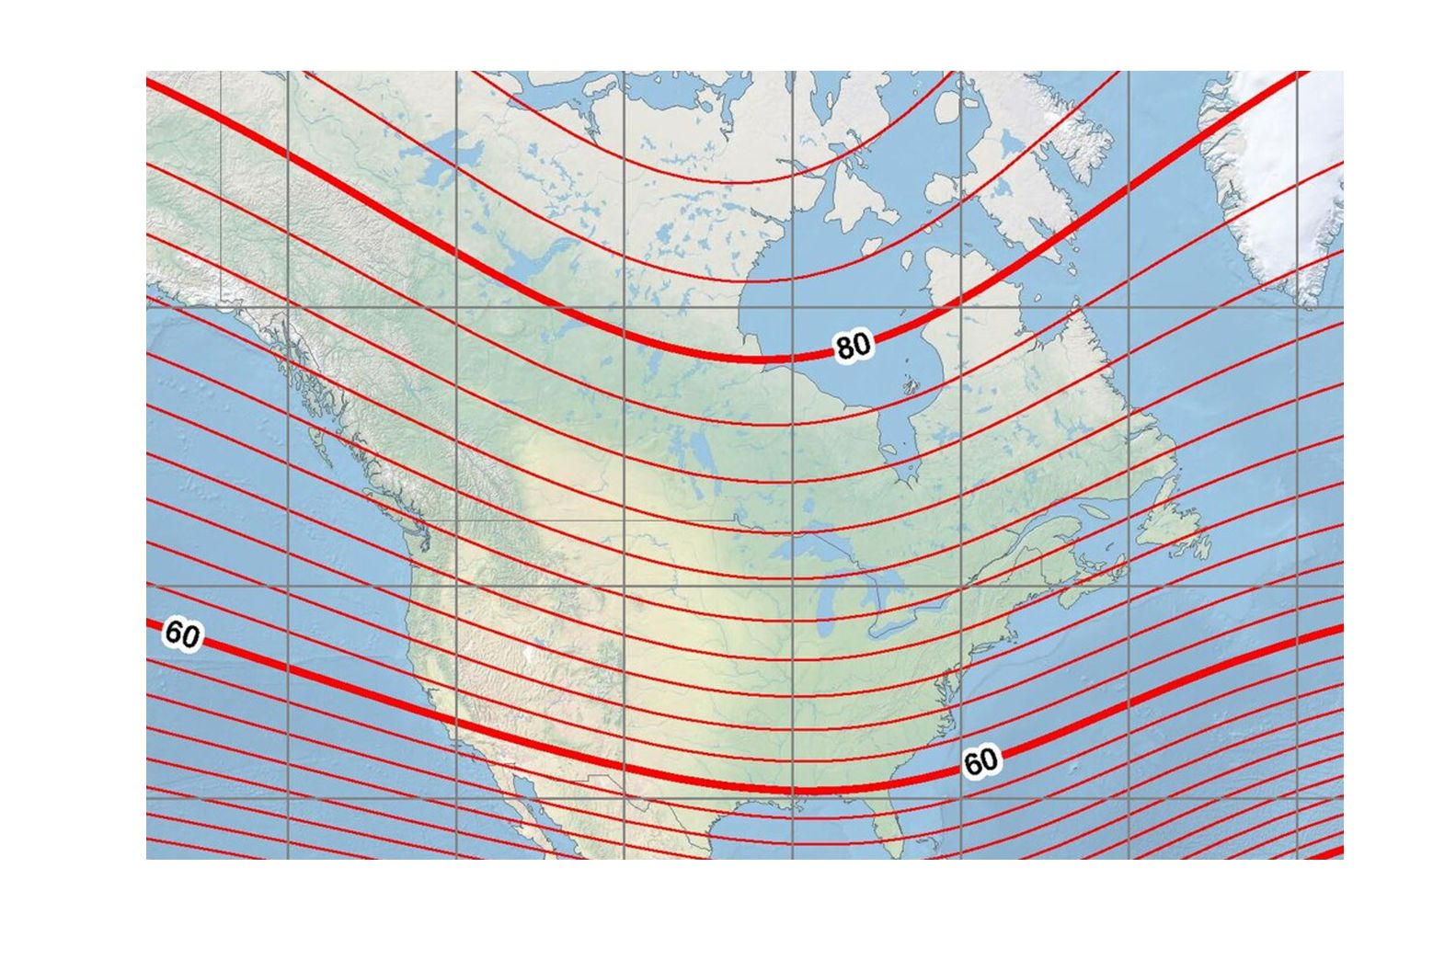
MAGNETIC INCLINATION MAP

Slide 9
The Earth’s Magnetosphere
The Solar Wind and the Interplanetary Magnetic Field, The IMF
The layout of Earth’s magnetosphere
Magnetic Field Lines: The Earth Magnetic Dipole
Polar Cusp Area of very weak magnetic field
Magnetotail
Size of, and the effect of Solar wind on the Magnetotail.
Neutral Plasma Sheet
Connects to the Auroral Oval and Auroral Electrojets
Auroral scatter is centered at about 100+ km in E Layer

Slide 10
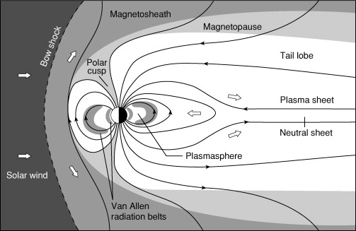
SCHEMATIC OF EARTH’S MAGNETOSPHERE

Slide 11
How does this all affect Auroral Scatter?
Scattering is only possible at an angle perpendicular to the magnetic field lines
The field lines vary with the geography No two spots are similar!
Field lines are more vertical as you go farther North
Magnetic storms will generate scattering farther South than during quiet periods.
Mono static RADAR will bounce signals off of a field line, but the return will only be perpendicular to the field inclination angle. What will the echo look like?

Slide 12
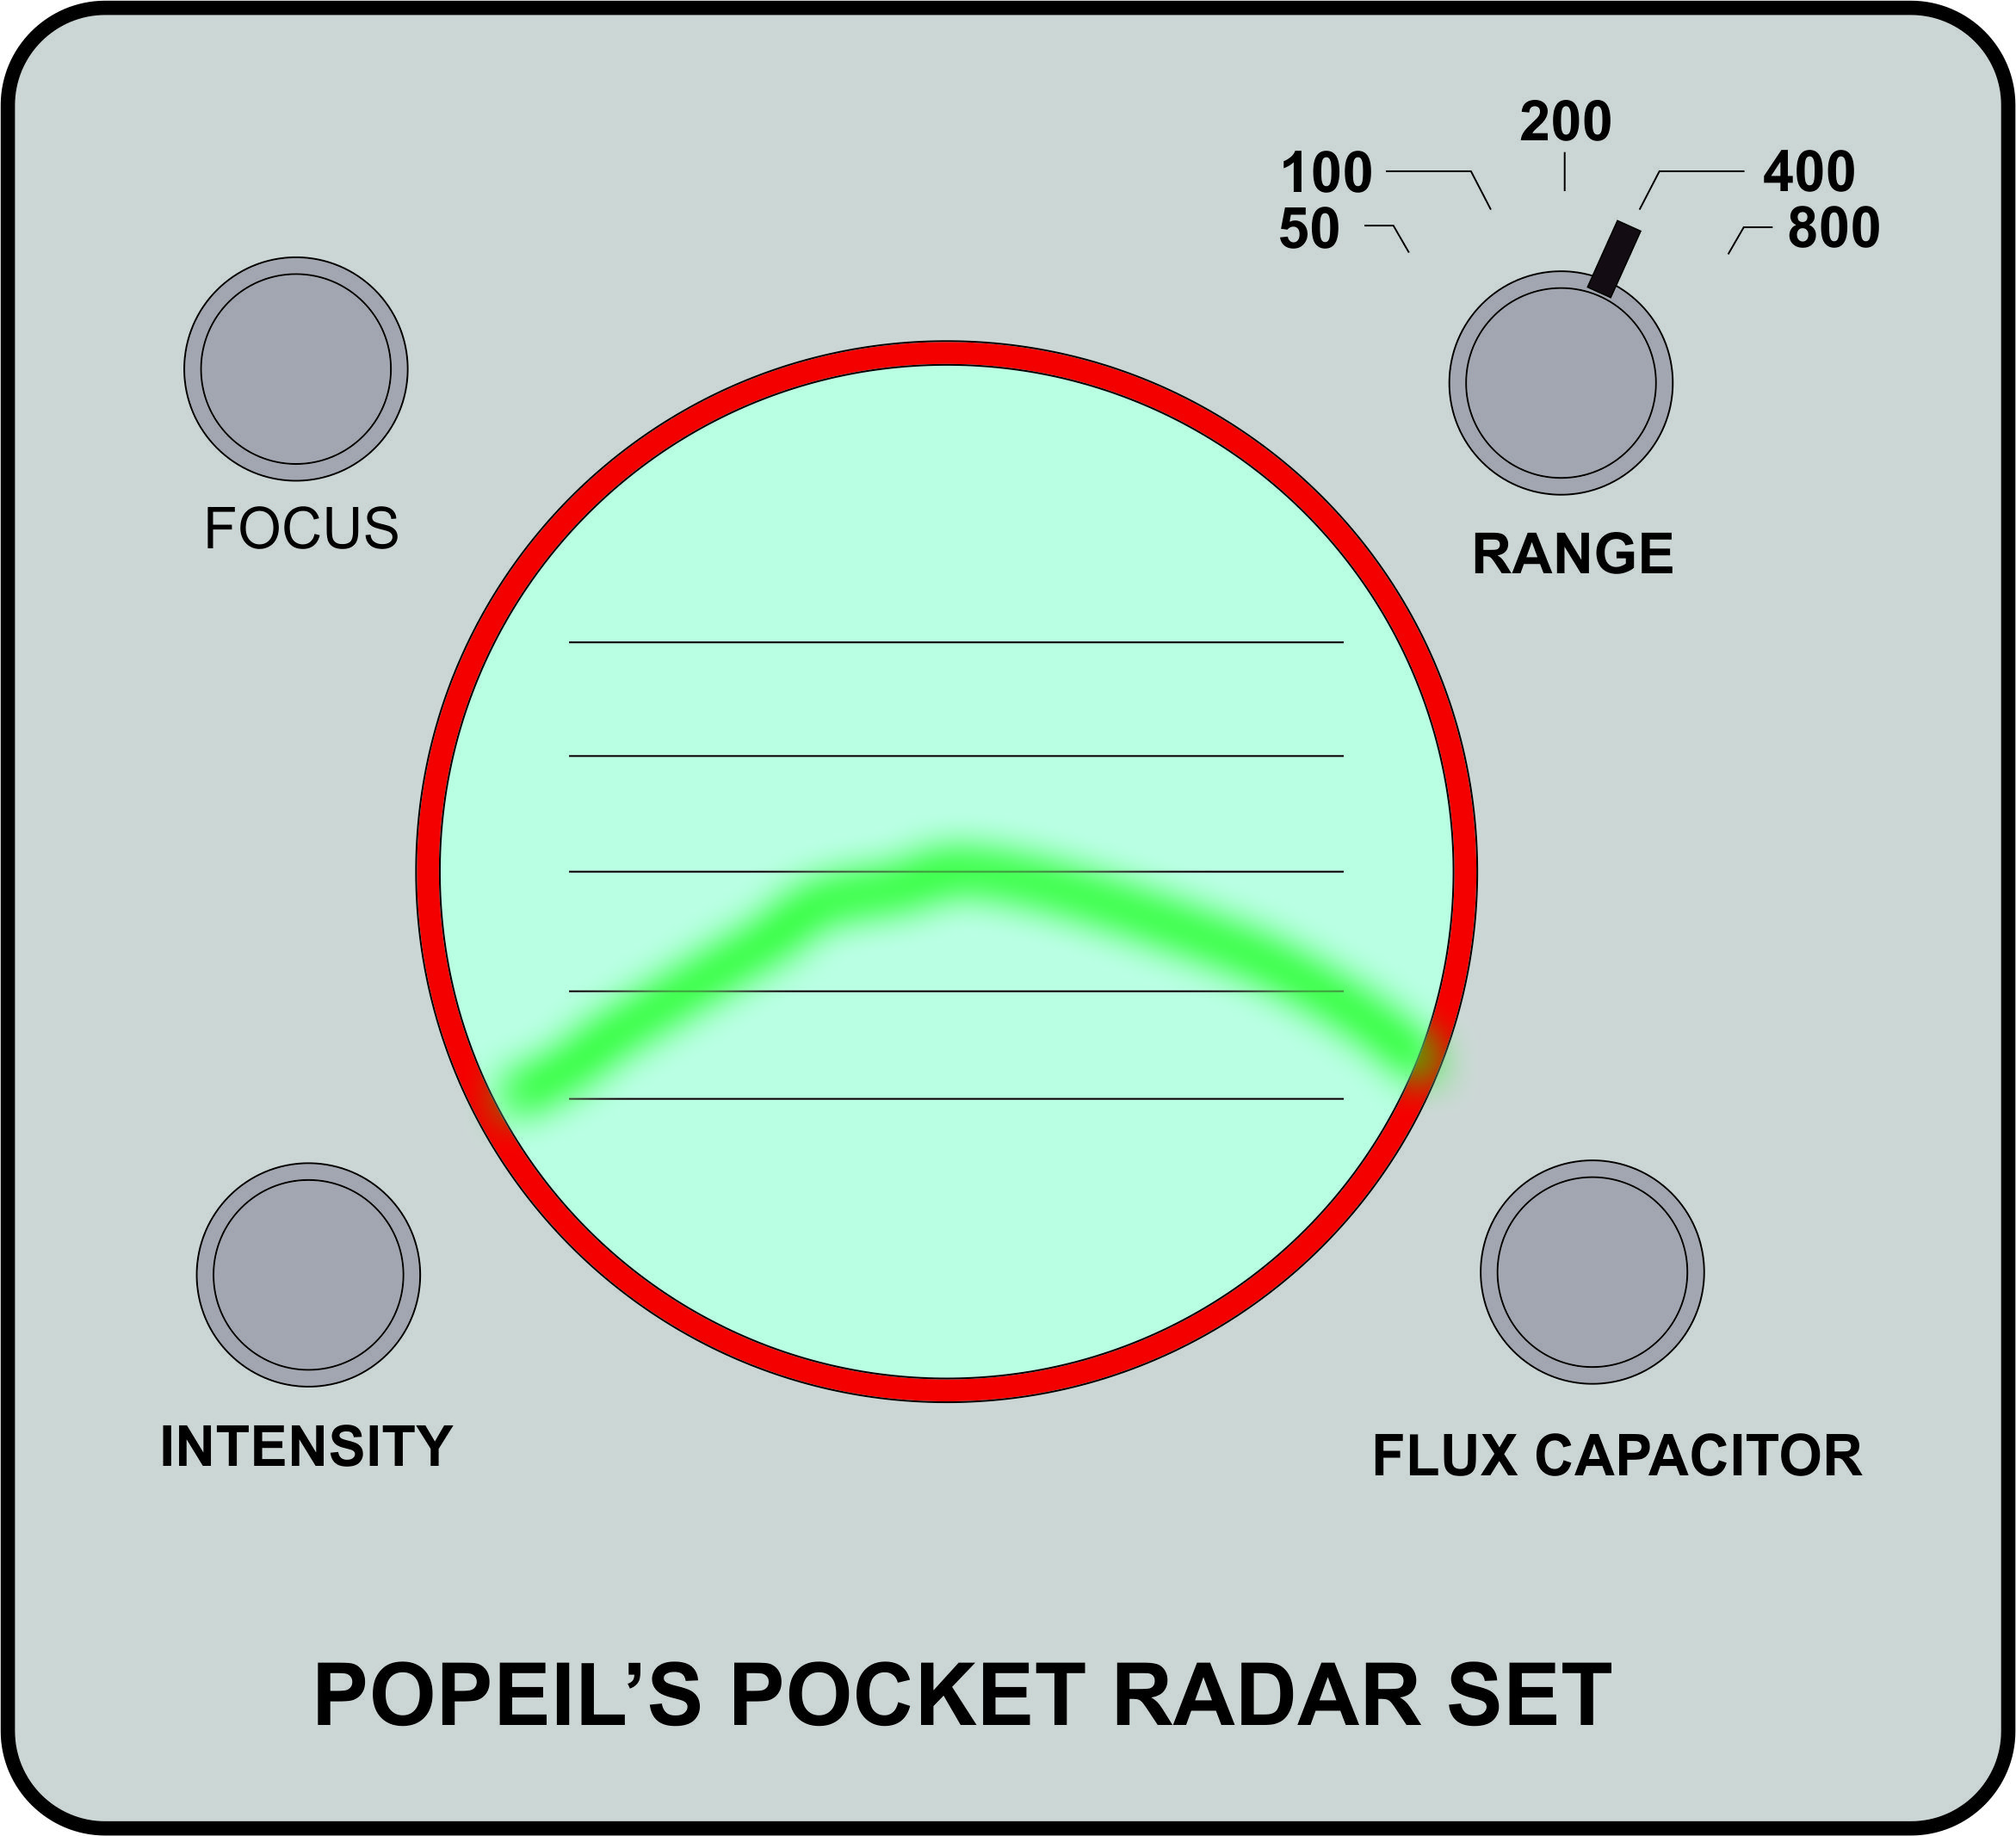
PLEASE EXCUSE THE CHEAP BARGAIN RADAR SET.
IT WAS BOUGHT FROM A LATE NITE UHF TV AD.

Slide 13
Let’s Look at a typical radio auroral path diagram to illustrate the situation

Slide 14
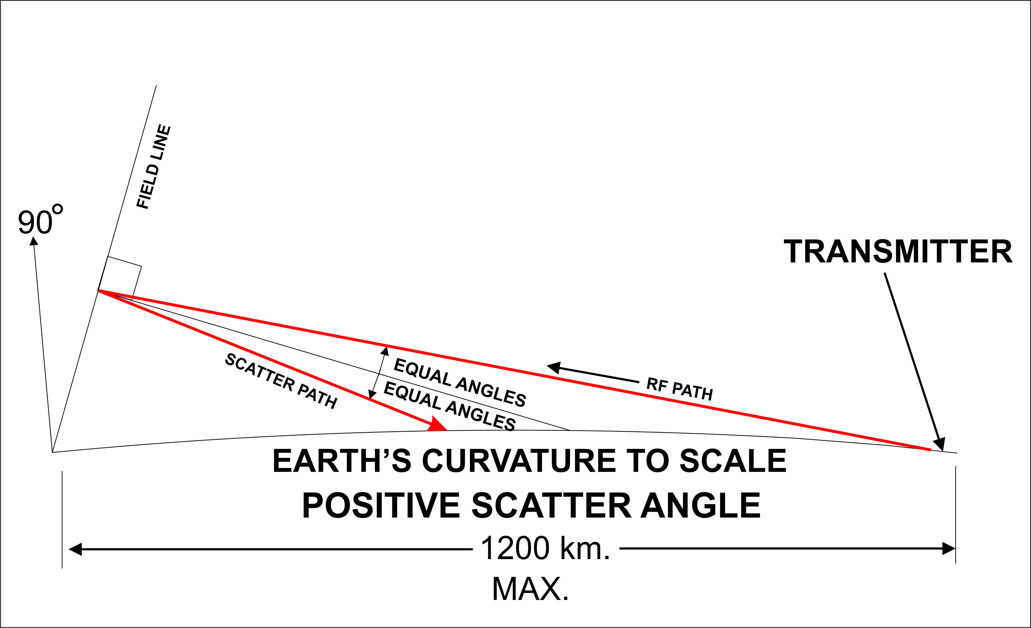

Slide 15
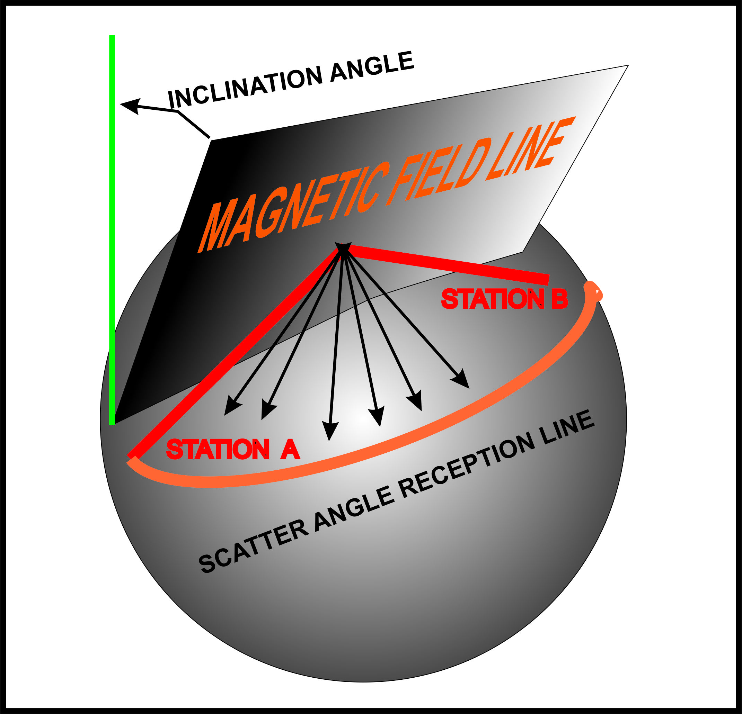
3D REPRESENTATION OF AURORAL SCATTER PATH
Station A is aimed at the -2 degree line and is receiving
Station B is aimed at about +2 degrees and transmitting

Slide 16
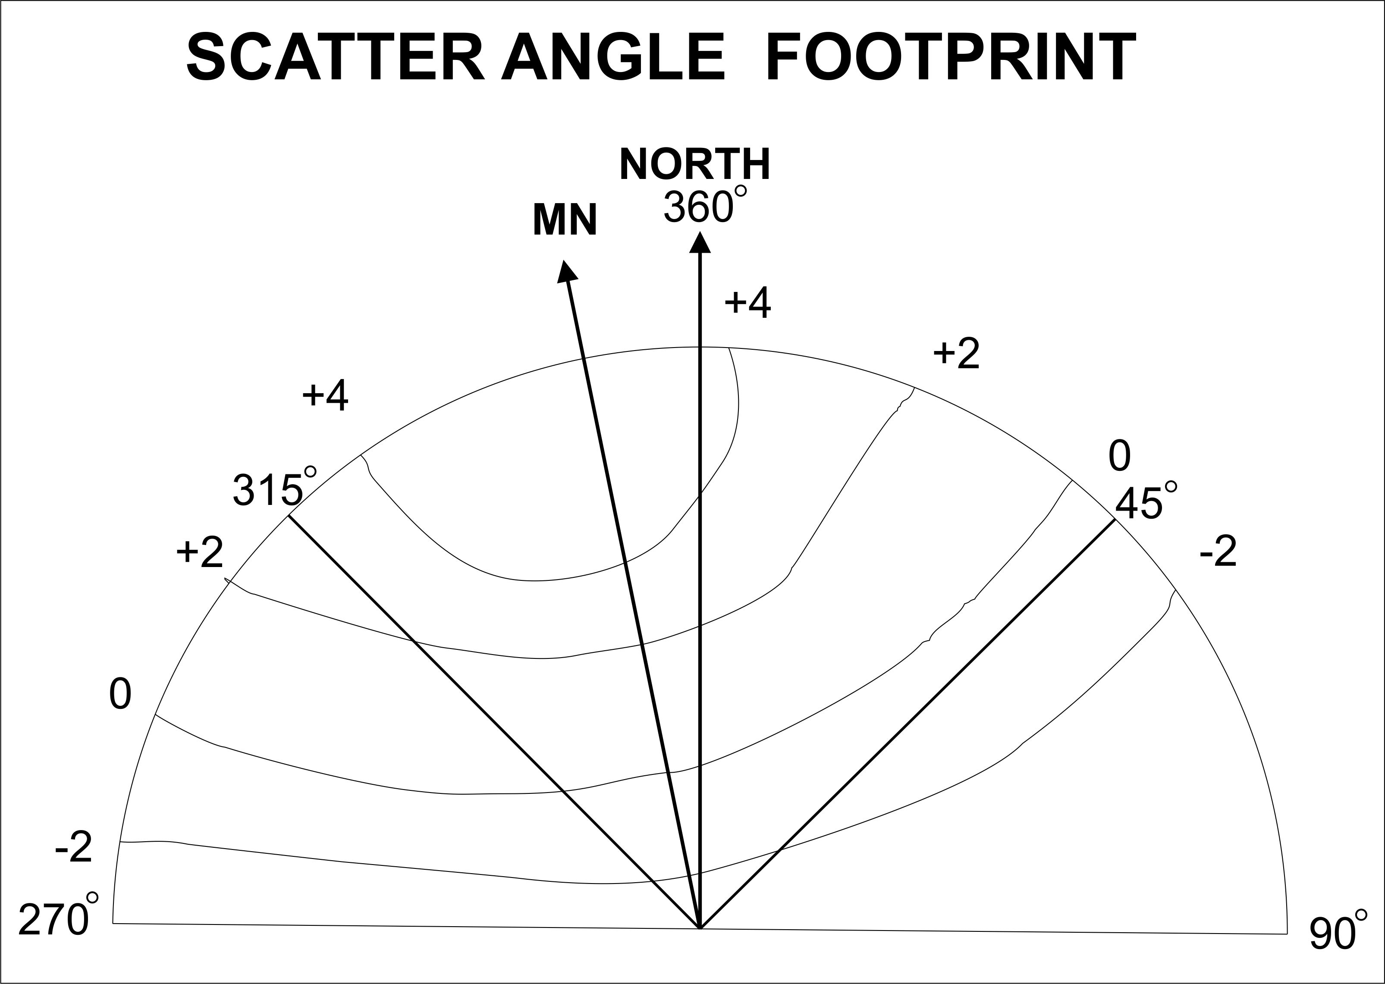
This footprint map is tilted to reflect the declination of New England.
The arc represents the horizon seen from New England. Azimuths are shown.

Slide 17
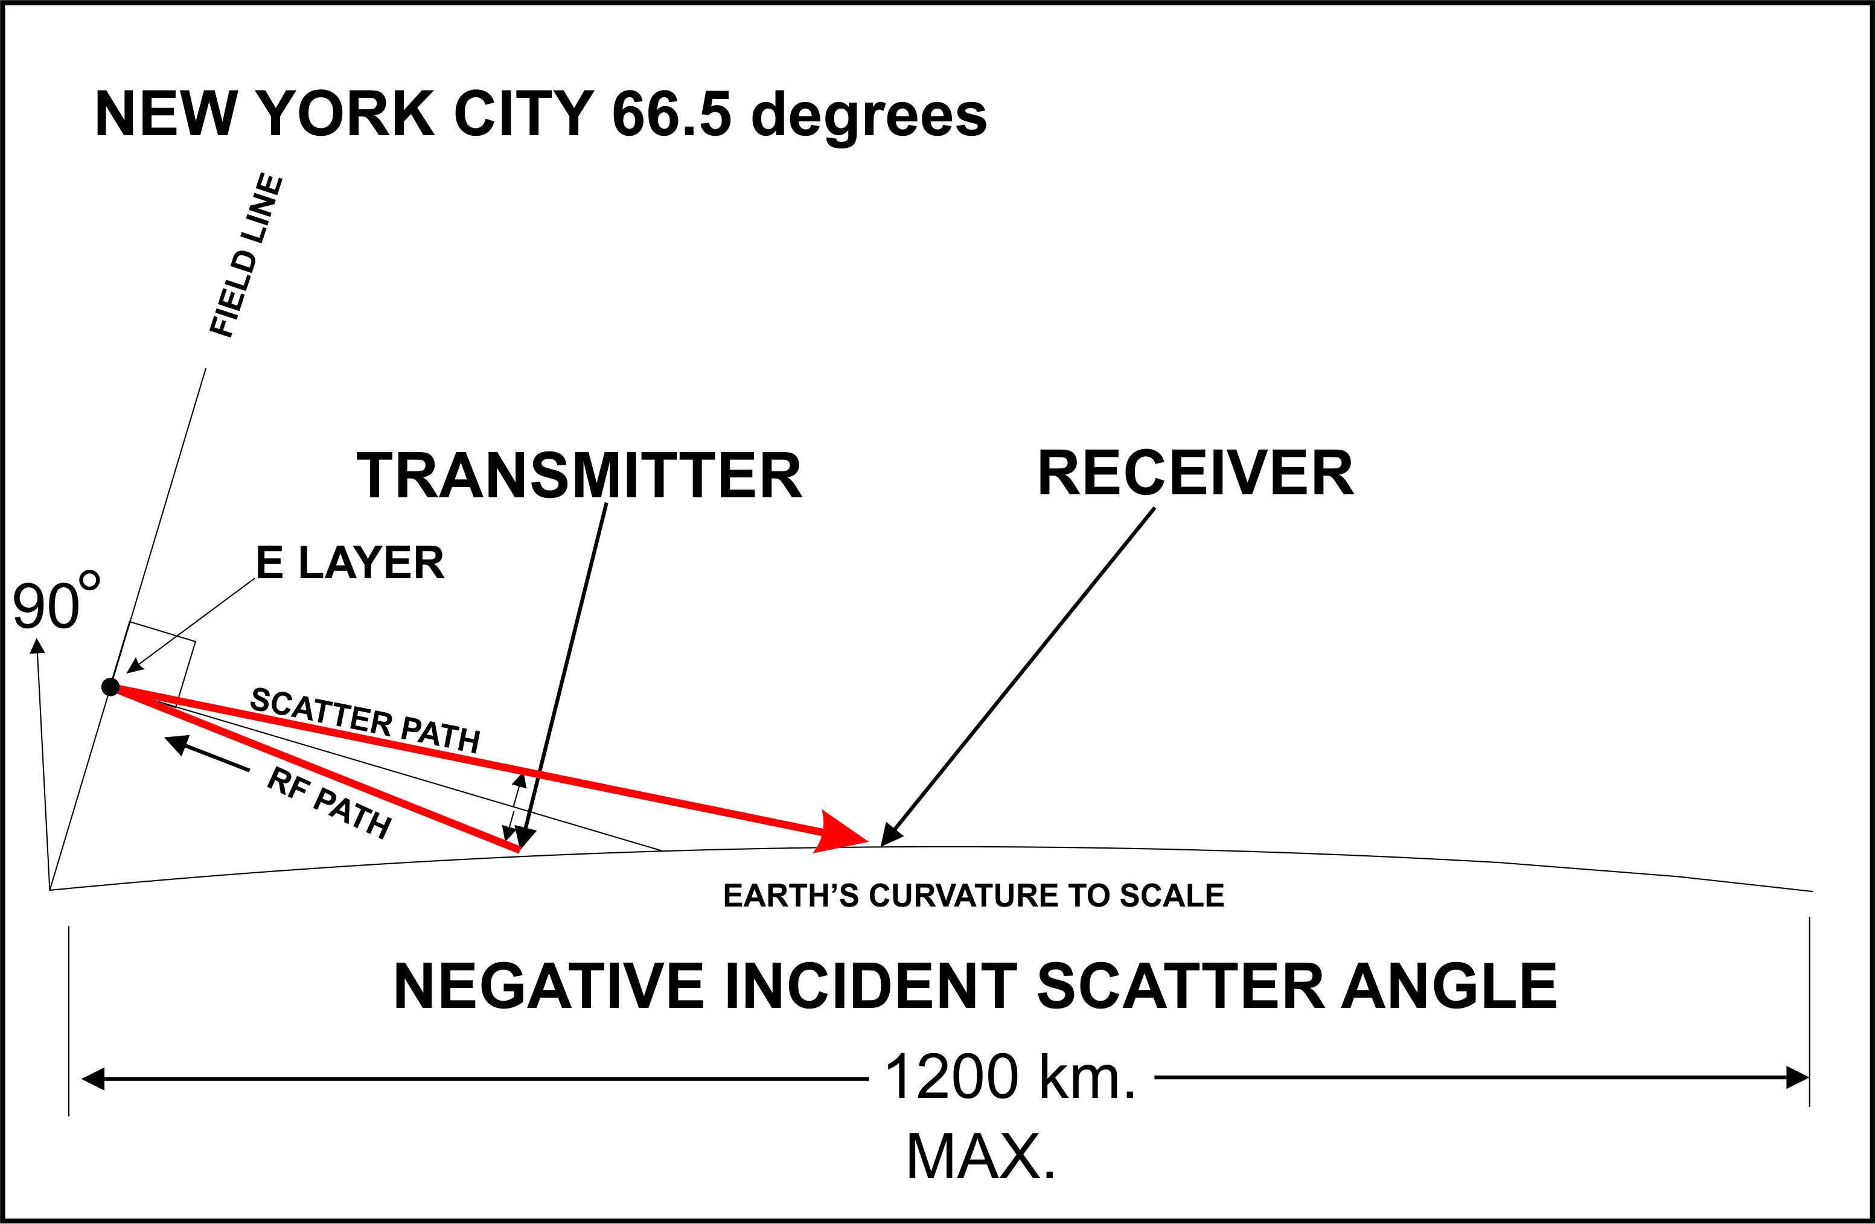

Slide 18
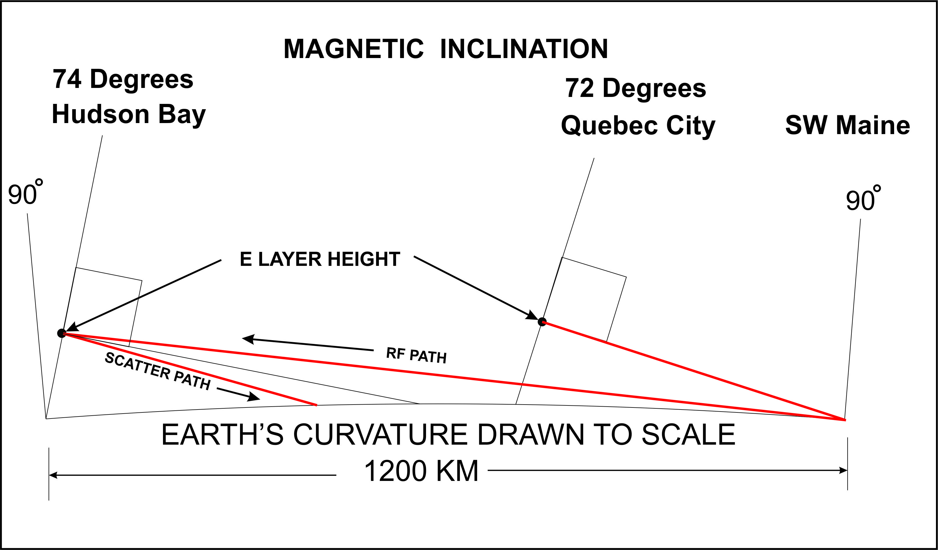
Two possible paths are shown depending on the strength of the Auroral storm.

Slide 19
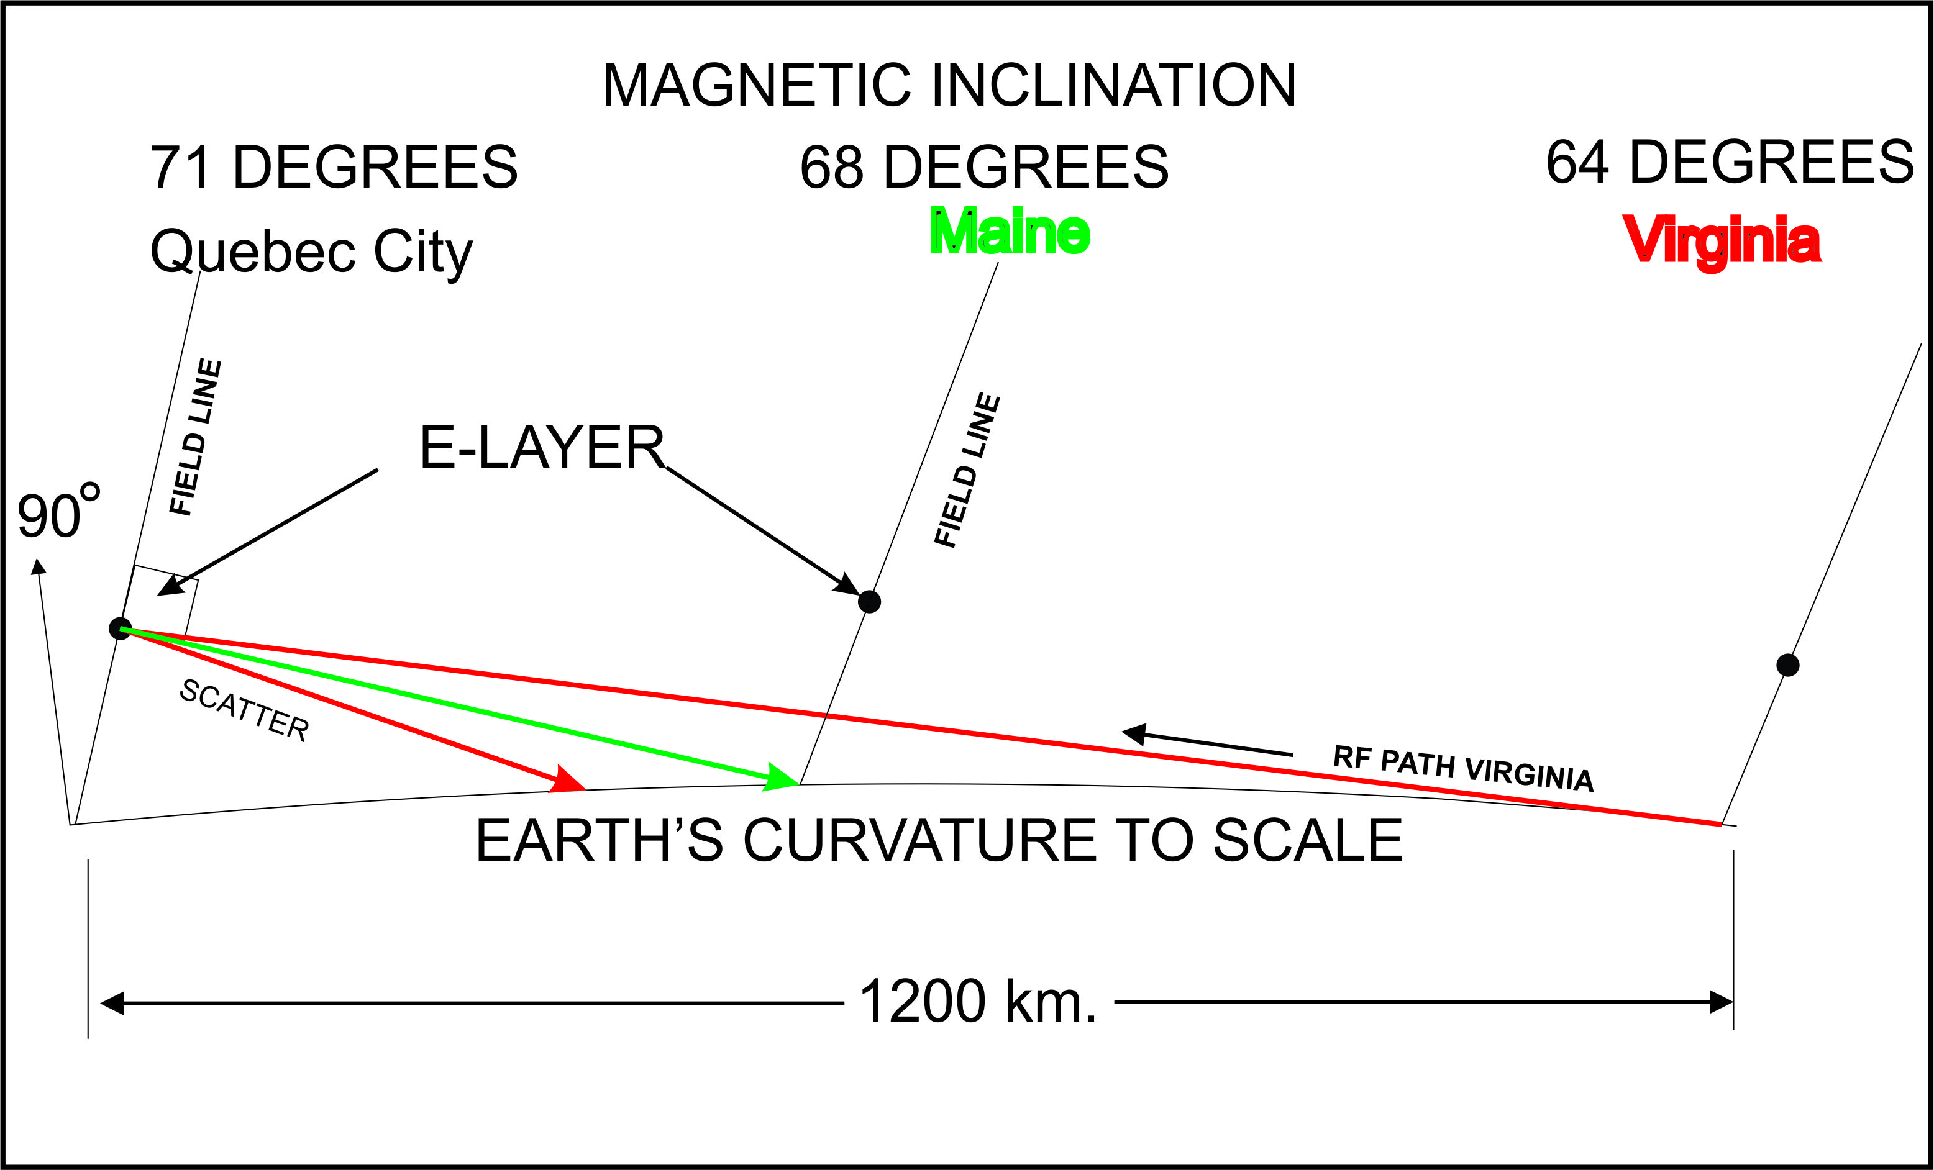
A North-South path requires the two stations to have LOS to the scattering field lines. Note that Maine is 0 degrees, while Virginia generates a +2 degree angle.

Slide 20
Is there a minimum range for AU scatter?
East-West paths limited by about 2X the LOS distance. 2000 km
North-South paths are limited by the 1200 km LOS distance of the Southern station.
You must subtract the distance from the scatter point to the Northern station from that 1200 km value.
The Northern station must be far enough away from the active field line for proper scattering to occur. This will reduce your N-S range.
This is not a problem with long East-West paths.
What happens if you are too close?

Slide 21
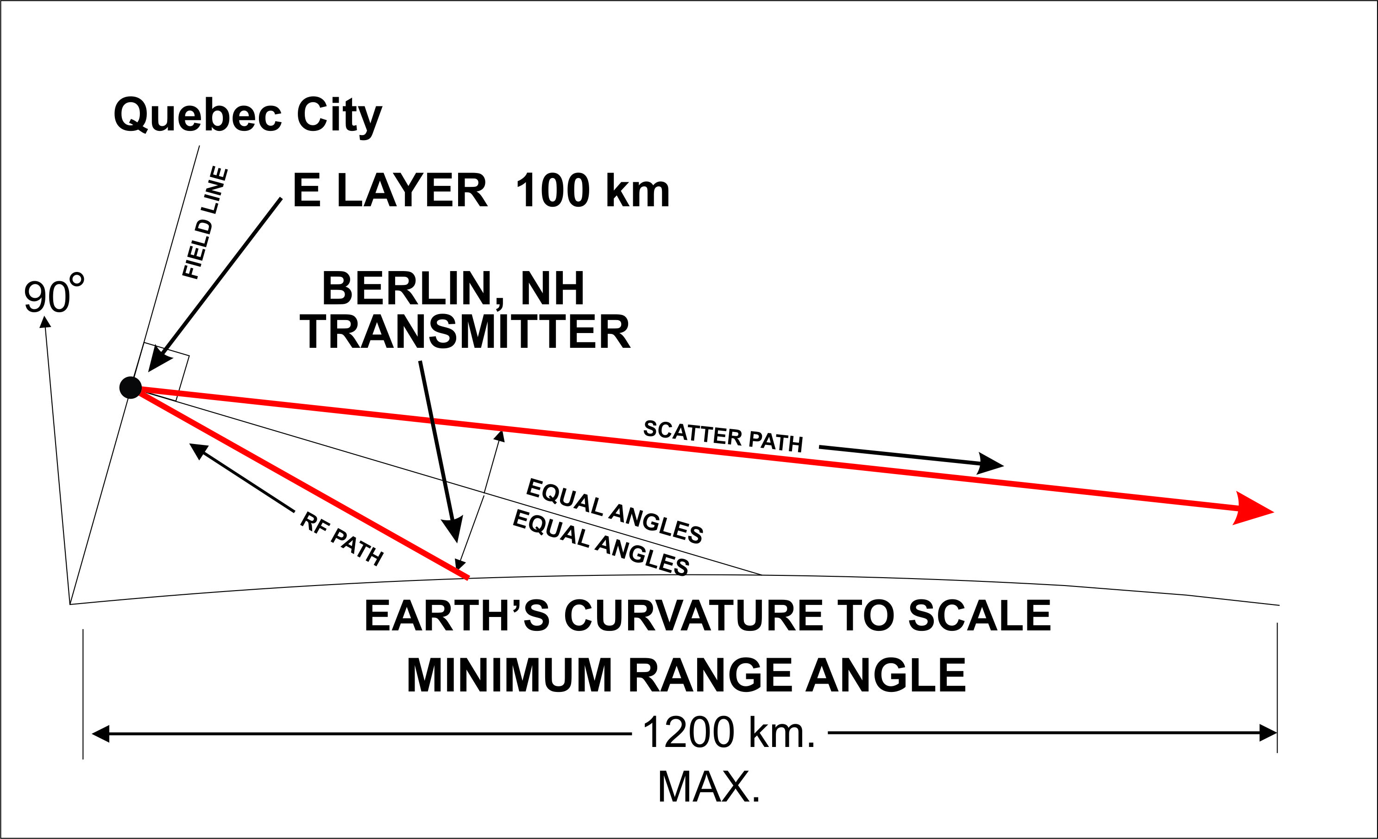
If you get too close to the scattering field lines on a North-South path, then you will overshoot the Earth. The signal will rapidly diminish.

Slide 22
Huge Aurora storm! The Aurora extends past you. What happens then?

Slide 23
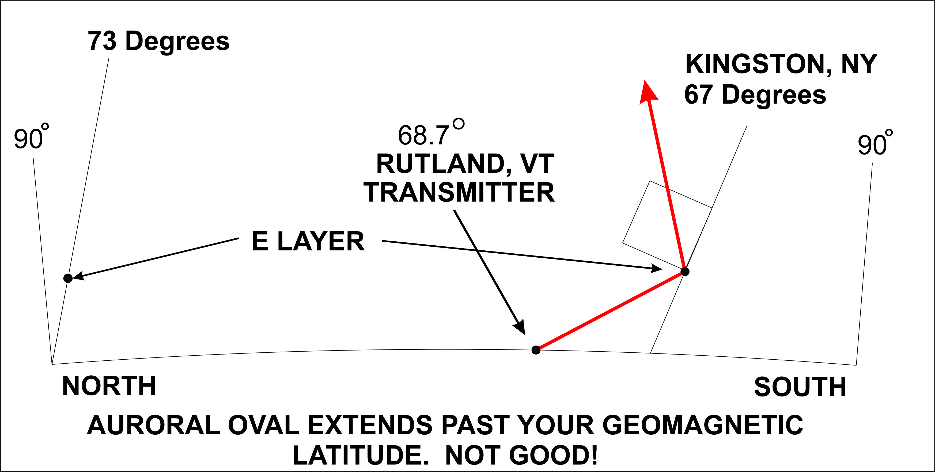
Rutland VT is North of the Scatter point field line. No matter where or what you do, the signal goes into outer space!

Slide 24
WHY DO AURORAS FADE OUT AND THEN COME BACK AFTER MIDNIGHT?
It all has to do with the electric currents in the Magnetosphere & E Layer. Solar wind energy is stored in the Magnetotail and moves to the Auroral Oval
The Auroral Oval is directly connected with field lines from the neutral plasma sheet and the magnetotail. This is where the energy comes from.
Electrons arrive on the dusk side of the Oval.
Protons on the morning side. Develops huge voltage gradient and high currents (Birkeland currents)
Large currents, the Auroral Electrojets, are located at the E layer

Slide 25
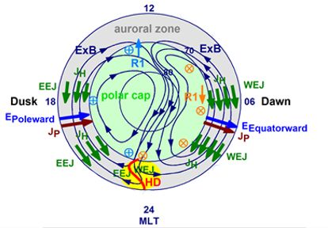
THE AURORAL ELECTROJET IN THE AURORAL OVAL
THE HARANG DISCONTINUITY HD

Slide 26
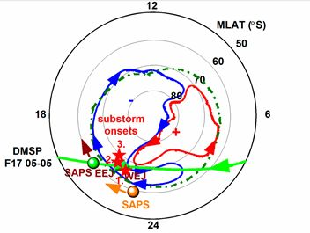
AURORAL ELECTROJET AND DISTORTIONS CREATED DURING SOLAR STORMS
Timing for Harang passage at your midnight MLT will vary due to distortion.
This is an actual Electrojet plot showing the two fields interlocking.

Slide 27
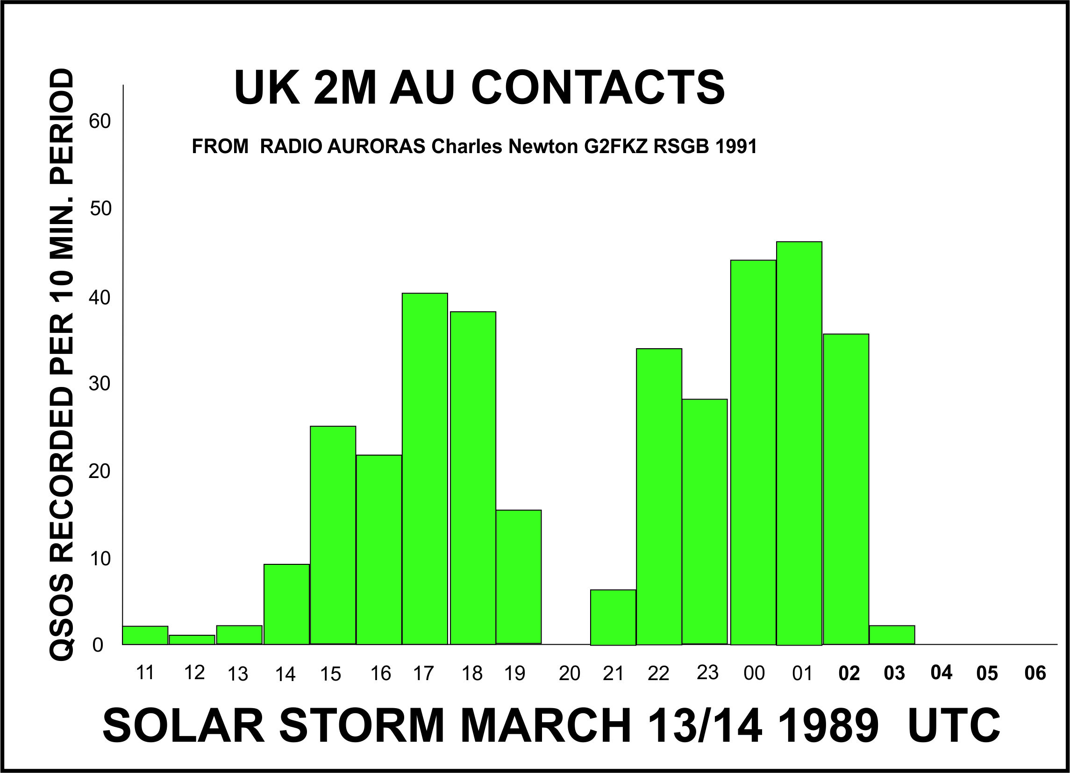
THE EFFECT OF THE HARANG DISCONTINUITY ON AURORAL SCATTER
Auroral Electrojet Reversal at Magnetic Local Midnight MLT = Magnetic Local Time

Slide 28
THERE IS SO MUCH MORE !
Doppler effects from drifting plasma
Attenuation due to path loss
The scatter point can be optimized
Short & very long hop better than two long hops
Attenuation due to lack of perpendicularity with the field lines. 10 dB per degree!
Scatter attenuation vs frequency. Signals fade with increased frequency. See W3EP article.
Much more to learn. My goal is to understand Auroral scatter and hope that we can use it more in the future.

Slide 29

THANK YOU

Slide 30
MAGNETIC INCLINATION MAP

Slide 31
